Slide 1
From One
To Two
Making it Work

Slide 2
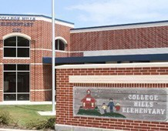
College Hills Elementary
Fall 2006-Present

Slide 3
College Hills Student Population
704 students
White 36%
Hispanic 30%
African American 20%
Other 14%
A Title I elementary school with a dual language program in grades K-4, Head Start classes in English and Spanish and an autism program.

Slide 4
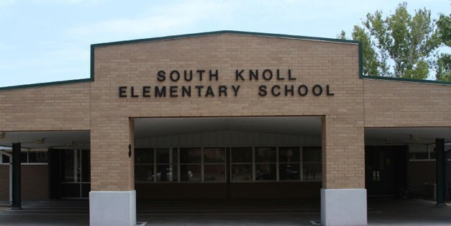
South Knoll Elementary
Fall 2011 - Present

Slide 5
South Knoll Student Population
685 Students
White 35 %
Hispanic 37 %
African American 16 %
Other 12%
A Title I elementary school with a dual language program in grades K-4, Head Start classes in English and Spanish, Pre-K, and Life Skills classes.

Slide 6
Making it Work: The Staffing
Full time paraprofessional M-F
Library assistant duties:
Daily lunch duty in cafeteria
Instructs grades K, 1, Head Start and Pre-K. (once per week)
Plans lessons with guidance.
Circulates books.
Enters and removes students from Destiny.
Prepares library cards for new students.
Conducts inventory every other year.
Assists with weeding, collection development and book fair.

Slide 7
Making it Work: The Schedule
2 ½ consecutive days (my schedule)
Two days per campus with one flex day
Other Models
Alternating weeks- every other week at one school
M-W-F one week
Tuesday, Thursday the next week

Slide 8
College Hills Elementary
Monday afternoon, Tuesday, Wednesday
Monday is Flex Day. No classes taught.
Tuesday and Wednesday are instructional days.
Individual homerooms in grades 2,3, & 4 scheduled every other week during their ELA instructional
block. ELA teacher brings students and remains.
30 minute lesson 20 instruction /10 book check out.
Open check out daily 8:00-8:30, 10:00-10:30, 2:35-3:00.

Slide 9
South Knoll Elementary
Monday morning, Thursday and Friday
Monday morning three classes are taught.
Thursday and Friday are instructional days.
Individual homerooms in grade 2 and two combined homerooms in grades 3 and 4 receive instruction weekly.
ELA teacher brings students and remains.
30 minute lesson in grade 2 with 20 instruction/10 check out
40 minute lesson in grades 3 and 4 with 25 instruction/15 check out
Open check out each day 8:00-8:30 and 2:00-3:00

Slide 10
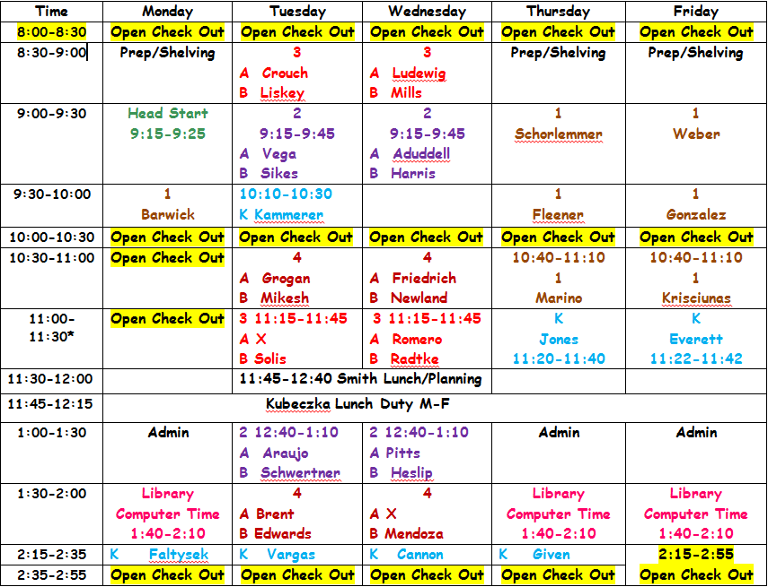
College Hills Library Schedule

Slide 11
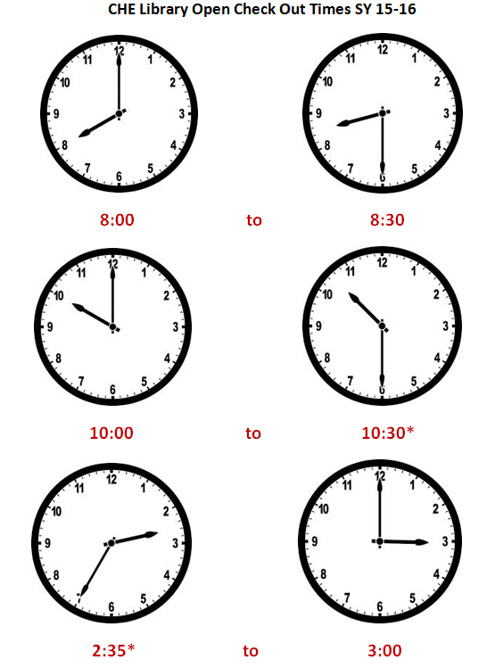
College Hills Open Check Out Times
Monday: Open Check out from 10:00-11:30
Friday: Open Check Out from 2:15-2:55

Slide 12
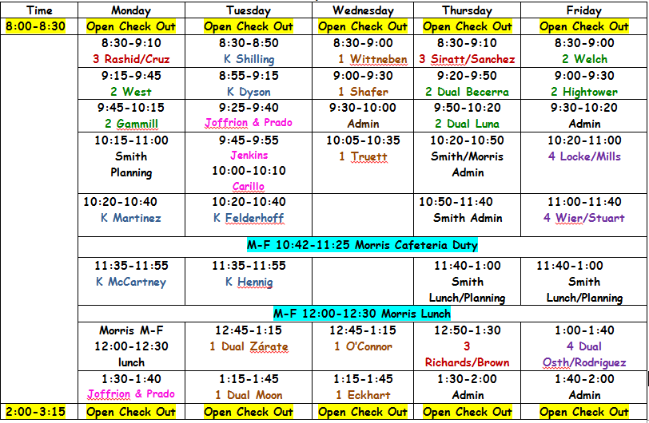
South Knoll Library Schedule

Slide 13
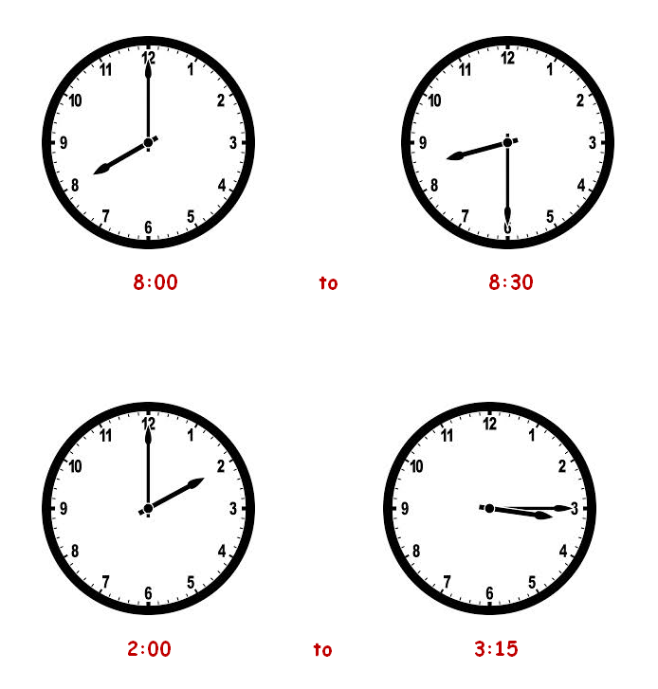
South Knoll Open Check Out Times

Slide 14
Making it Work: Two Collections
One collection informs the other.
Book order sharing between schools facilitates
collection development.
Working with two staffs provides greater opportunity for expanding curriculum support and enriching instruction.

Slide 15
Making it Work: Outreach & Collaboration
Coordinate library classes with ELA teachers.
Share usernames and passwords (library research and ebook sites) on bookmarks electronically. A printed bookmark is placed in student weekly take home folders and housed beside all library student computers.
Promote book fair/ special reading programs through PTO newsletter and school social media pages.
Inspire and share through author and illustrator visits, family reading nights and public librarian presentations to promote summer reading programs during final library classes.

Slide 16
Outreach and collaboration
Share best practices in research through staff development or with grade level teams/individual teachers and in library classes.
Make campus literacy specialists aware of subscription literature and research sites to share with grade level teams.
Share Capstone ebooks with resource teachers to engage reluctant readers.
Create and share Destiny public resource lists for STEM and research topics and grade level units of study.
Attend monthly meetings with district librarians.
Use the book fair as a soapbox.

Slide 17
Contact Information
Email ssmith@csisd.org
Website mrssmithslibraries.weebly.com
College Hills Elementary 979-764-5565
Monday afternoon, Tuesday and Wednesday
South Knoll Elementary 979-764-5580
Monday morning, Thursday and Friday

